Slide 2
Our Mission
Our Vision
Educate On
Harmonisation Approach
River of Life,
Fullness of Life
Non-invasive
Natural Healing @ root cause
Scientifically Proven using latest Technologies + working with quality partners
BUILD A WORLD FULL OF
HEALTHY & WEALTHY PEOPLE

Slide 3
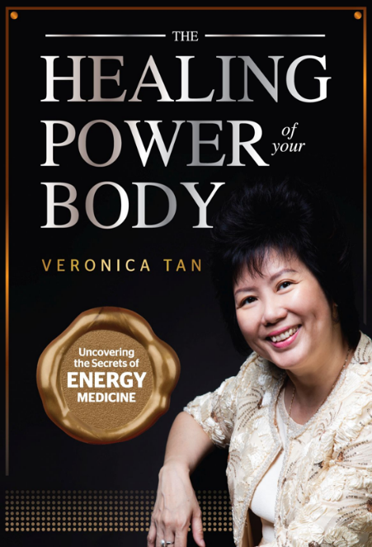
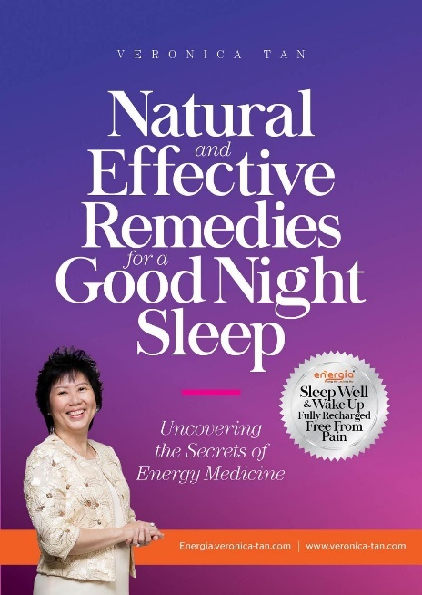
Enjoy Quality of Life Sleep Well, Eat Well, Live Well

Slide 4
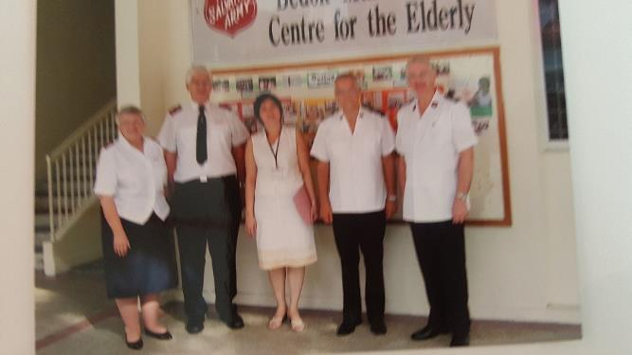
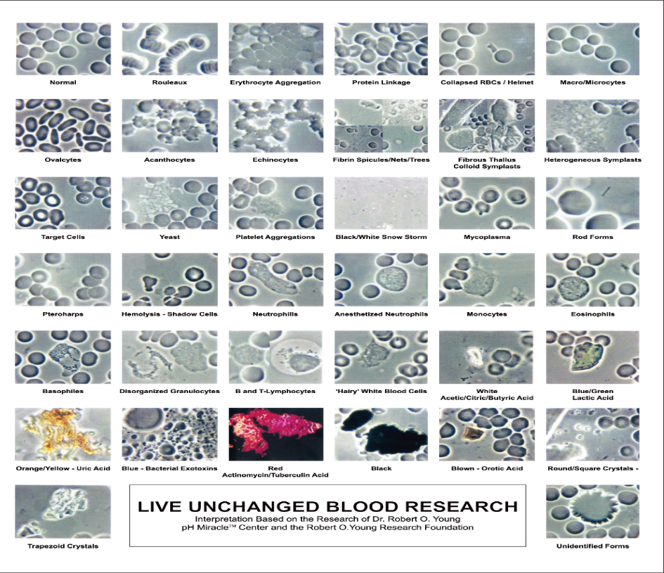
About the speaker Veronica Tan, SRN
Nurse manager with The Salvation Army for 14 years
On medication for more than 10 years for Grave’s Disease since year 2000
Felt easily tired and unable to sleep well
Started Rev 22 Pte Ltd in 2010 to heal herself through sleeping on Energia sleeping system
Her blood cells improved in 9 months without medication. Clinical report was normal.

Slide 5
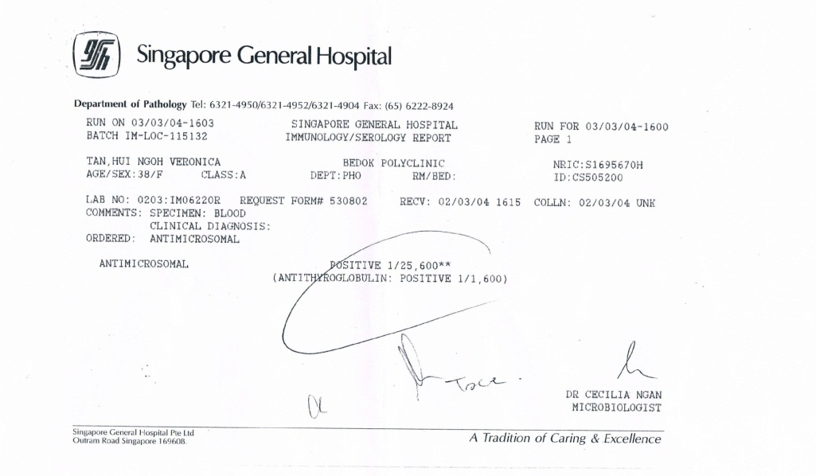
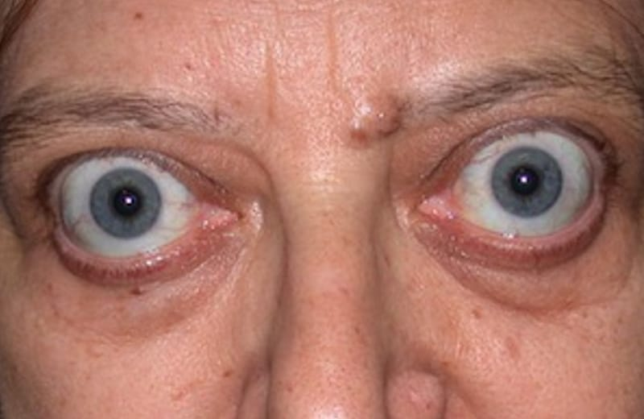
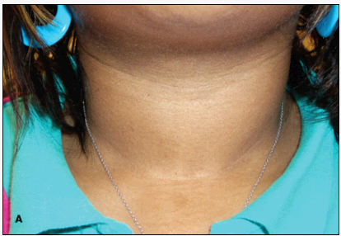
2000 年
甲状腺功能亢进症 (Grave’s Disease)
Easily fatigue, poor quality sleep
Heart rate 120 to 140/min with palpitation

Slide 6
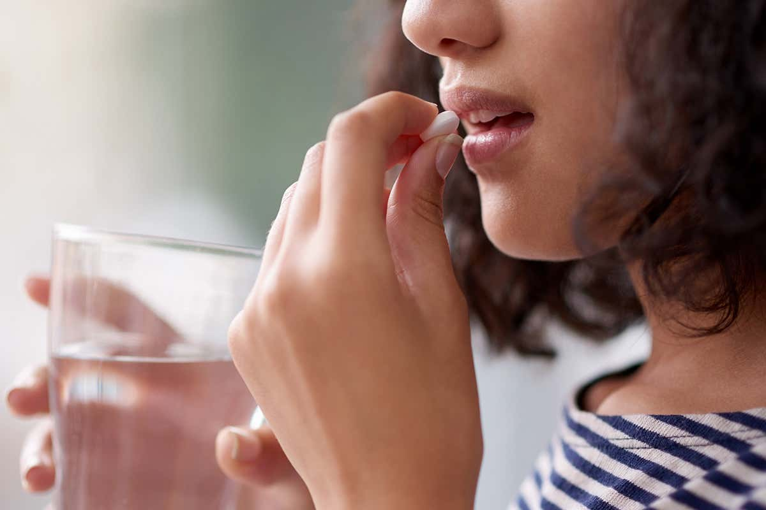
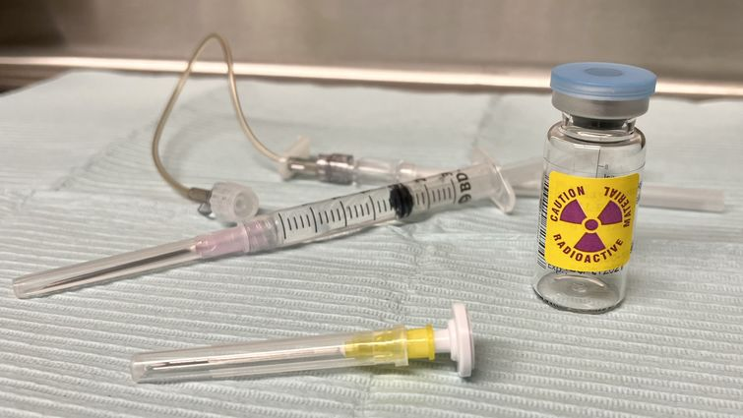
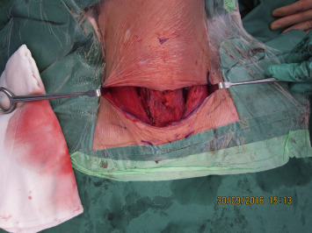
甲状腺切除术
医生强烈推荐药物治疗;
Medical Recommendations
长期用药; Long term medication
甲状腺切除术, Surgery
放射活性碘治疗; Radio active iodine

Slide 7
My Turning Point
February 2011 (8 months later)
December 2010 (6 months later)
July 2010 (1 month later)
June 2010 (Before therapy)
Notes:
Her turning point:
In May 2010, she met the inventor of Energia product. He was very confident to solve her medical condition.
After using the solution for a period of time, Veronica decided
to stop medication
to stop seeing her doctor
She listened to her body for any sign of relapse such as heart rate ↑120 to 140 per min, easily breathlessness, lack of stamina, unable sleep at night, sweaty palm. Whenever relapse, she would need medication to control her thyroxine level
She had a microscope to check her own blood
It was the first time in her life, she saw her own red blood cells under the microscope. These blood cells carry oxygen and nutrients to our brain, heart, lungs, liver, kidneys. They must be healthy to do a good job. They cannot be clustered like theses …
In June 2010 – she had very clustered blood (acidic blood with not enough oxygen; blood cells not healthy)
In July 2010 – Toxic crystals appeared – bowel toxic and heavy metal
In Dec 2010 – blood cells were much healthier but hollow – sign of anaemic cells. Can you see, her blood cells were so much healthier; individual pieces as compared to that in June???
In Feb 2011, almost 9 months later, her blood cells were perfect.

Slide 8
Clinical Blood Test on 17 Feb 2011 (8 months later)
Without Medications
←within Normal range
Notes:
In Feb 2011, she went for clinical check just to confirm that there would be no relapse

Slide 9
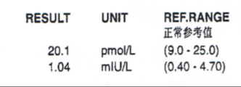
Clinical Blood Test on 17 Aug 2012 (26 mths later)
Without Medications
Within normal range →
Notes:
26 months later, she did not have any relapse

Slide 10
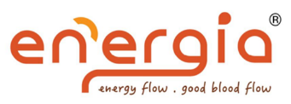
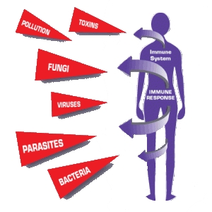
Improved Immunity
Body is kept Homeostatic like a healthy pot of soil:
Enjoy deep quality sleep
Healthy blood pH at 7.36 (alkaline)
Healthy blood cells - well separated and well oxygenated with healthy energy level
Healthy lymphatic drainage
Cleanse congested liver with effective liver detox
Cleanse colon with quality fibre
Ensure adequate good bacteria to protect colon
Adequate nutrients from healthy food
Adequate hydration with quality water
Notes:
Supporting Slides

Slide 11
Energia Technologies
Acugraph Energy Analysis (US Technology)
Energia Power Therapies
(Service Your Body While You Are Still Young & Healthy)

Slide 12
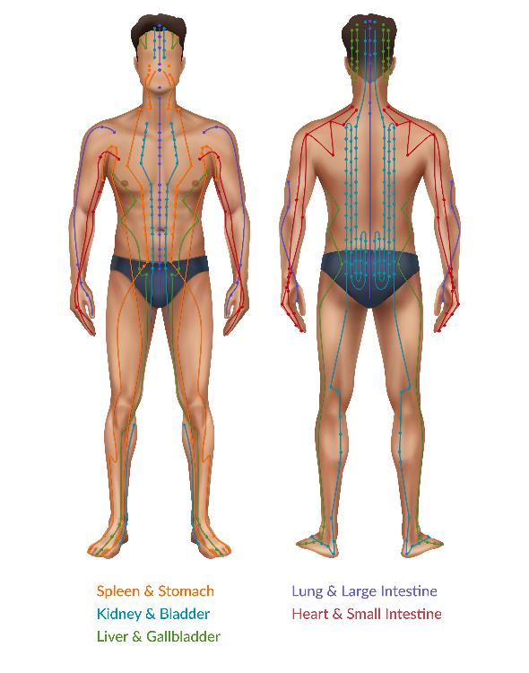
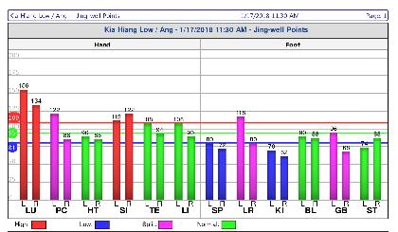
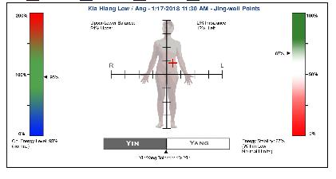
Traditional Chinese Medicine (TCM)
Pulsating
12 meridian points (feel the “qi” or “energy” flow)
Acugraph Energy Analysis and Consultation
Energetic imbalances may contribute to negative health conditions.
Acugraph, a digital meridian imaging system, is used to measure the energy level or your body’s 12 organs
meridian
Now Scientific!
USA Technology
Lungs
Pericardium
Heart
Small Intestine
Triple Energiser
Large Intestine
Spleen
Liver
Kidneys
Bladder
Gallbladder
Stomach
Notes:
So, how does our immune system work?

Slide 13
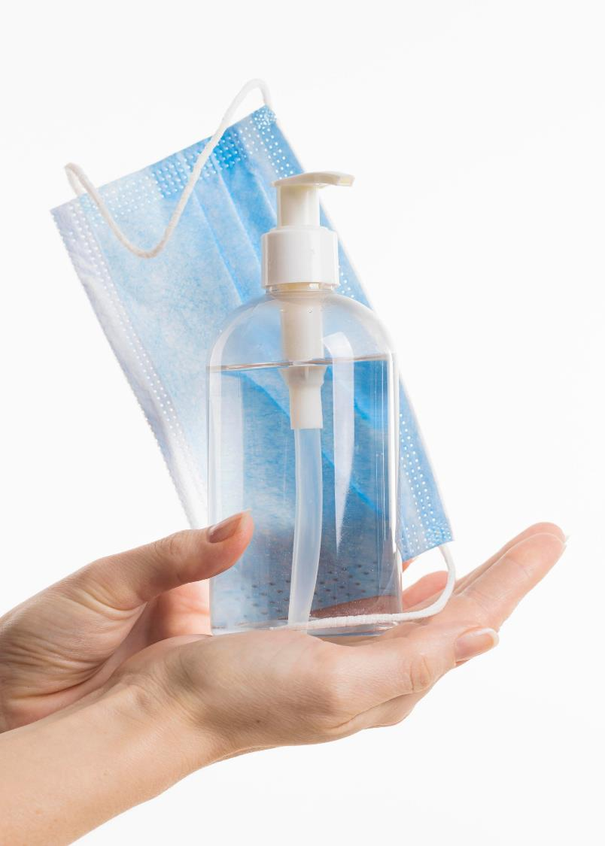
Contact-less concept
Pampering your
Body the safe way
as we live in a new norm, Energia continues to use high-tech equipment that offers the same high-quality treatments minus the risks of
human-to-human contact

Slide 14
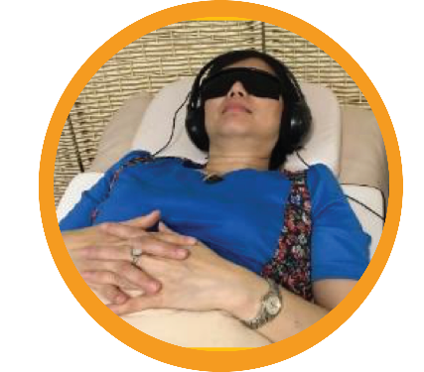
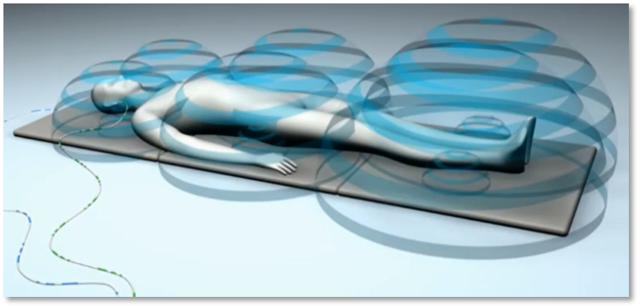
01
Power Recharge Therapy
(German technology)
Benefits
The combination of :
Improves sleep quality wake up feeling recharged and happy
Regenerates body cells and bone structures
Increases tissue oxygenation for natural health restoration
May reduce need for medication
Cell therapy
Light therapy
Sound therapy
(Energy resonance mat)
(Led light with glasses)
(Theta waves with earpiece)

Slide 15
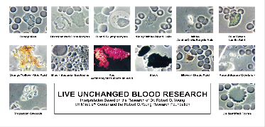
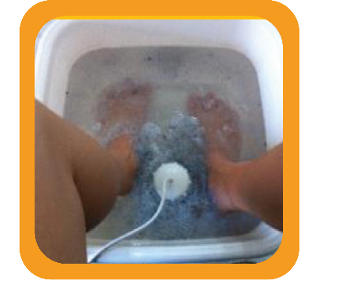
02
Power Foot Detox Therapy
Benefits
(German technology)
Enhances detoxification by effectively removing coloured crystals that are present in blood microscopy
Improves blood circulation
Increases energy of body cells
Uses zinc electrode and
Scented Himalayan salt for body to expel
Toxins into water and absorb
Good minerals back into the body

Slide 16
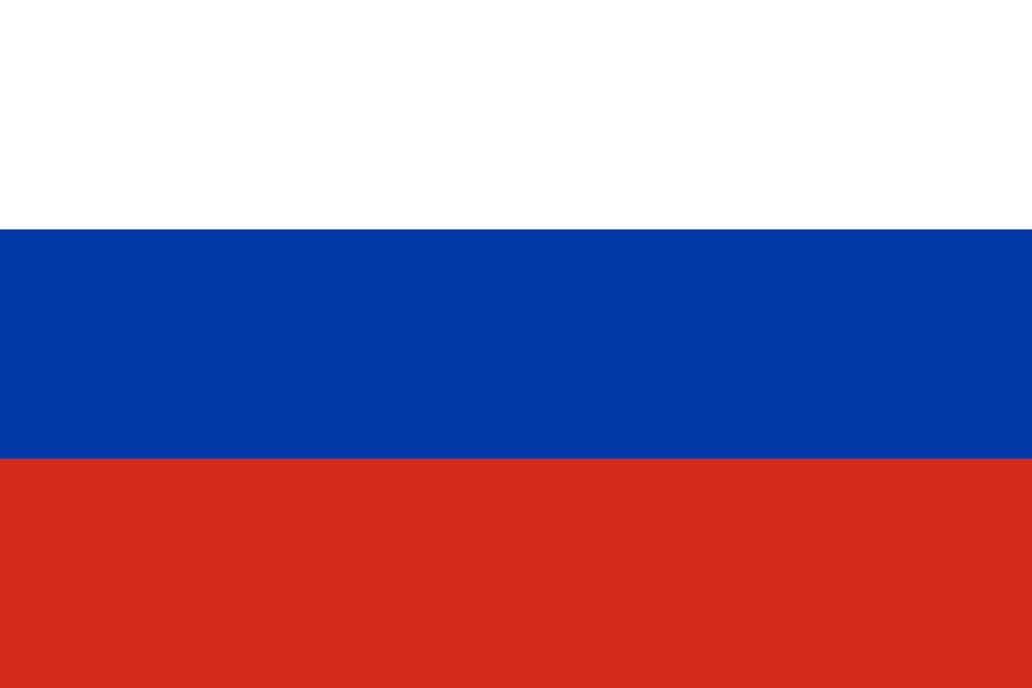
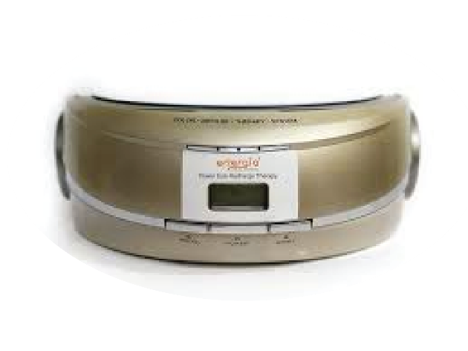
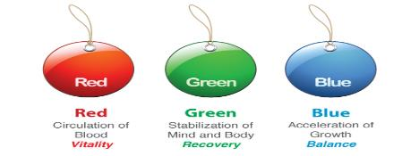
03
Power Eye Recharge Therapy
Decreases eye strain
Relieves eye discomfort, tired eyes, dry or teary eyes, red eyes
Promotes eye exercise to strengthen eye muscle
Russian technology
With Korea patented “colour impulse therapy”
Benefits
Non-invasive vision correction
Coloured impulse led beam light therapy uses both the frequency of color and unique rhythm of
pulsating light to prevent and mediate visual and other disorders

Slide 17
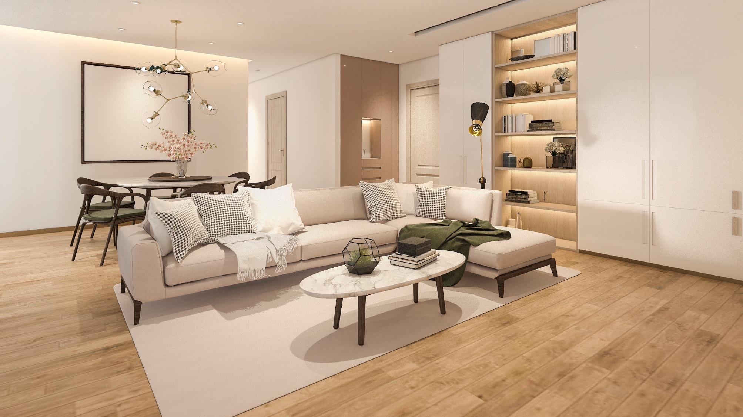
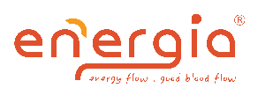
HOME CARE
PRODUCTS
ENERGIA

Slide 19
Energia Fibre Technology
Energia beads emit far infrared rays and negative ions which can convert drinking water to alkaline water without the need for electric current.
The Energia beads are grounded into powder without losing its beneficial properties
The Energia beads are integrated into the Energia fibre or Energia fabric using Nanotechnology

Slide 20
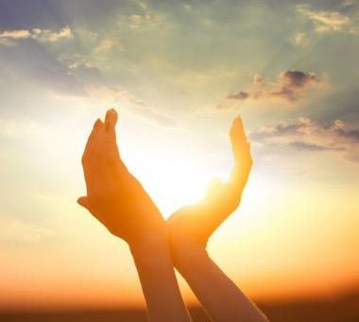
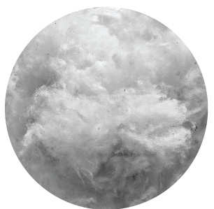
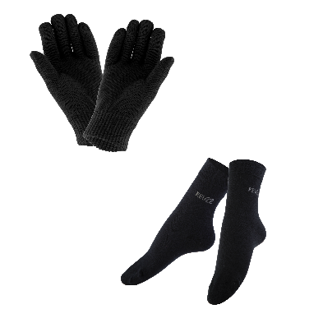
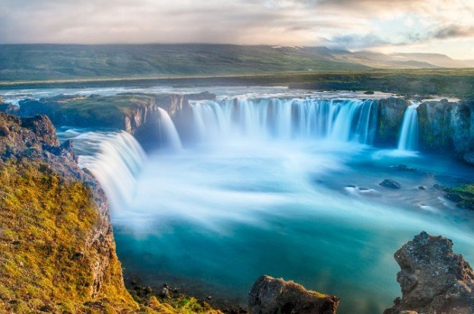
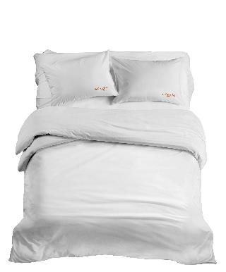
Energia Energy Fibre
Let Nanotechnology and Mother Nature Improve your Blood Flow and Energy Flow
100% natural (non-electrical or magnet)
Safe for Newborn, Pregnancy, Elderly, Patients with pacemaker
Far Infrared Rays
Good Energy Flow
This natural sunrise energy restores body’s “chi” and is capable of penetrating deep into the body and the underlying tissues.
Improves blood flow and energy flow
Improves detoxification, skin texture and immunity
Reactivates our biological clock for better sleep, higher energy and clarity of mind.
Negative Ions
Good Blood Flow
Found in nature around waterfalls, beaches, forests and in all Energia products
Keeps the blood well-oxygenated and alkaline
Oxygenates major organs
Improves alertness, concentration and physical energy
Notes:
Stress on the technology again
Bringing sunrise and waterfall back home

Slide 21
Home Care Products

Slide 22
Improved Immunity
Body is kept Homeostatic like a healthy pot of soil:
Enjoy deep quality sleep
Healthy blood pH at 7.36 (alkaline)
Healthy blood cells - well separated and well oxygenated
Healthy lymphatic drainage
Cleanse congested liver with effective liver detox
Cleanse colon with quality fibre
Ensure adequate good bacteria to protect colon
Adequate nutrients from healthy food
Adequate hydration with quality water
Notes:
Supporting Slides

Slide 23
Quantum Resonance Magnetic
Scanning (German Technology)
(107 pages comprehensive report)

Slide 25
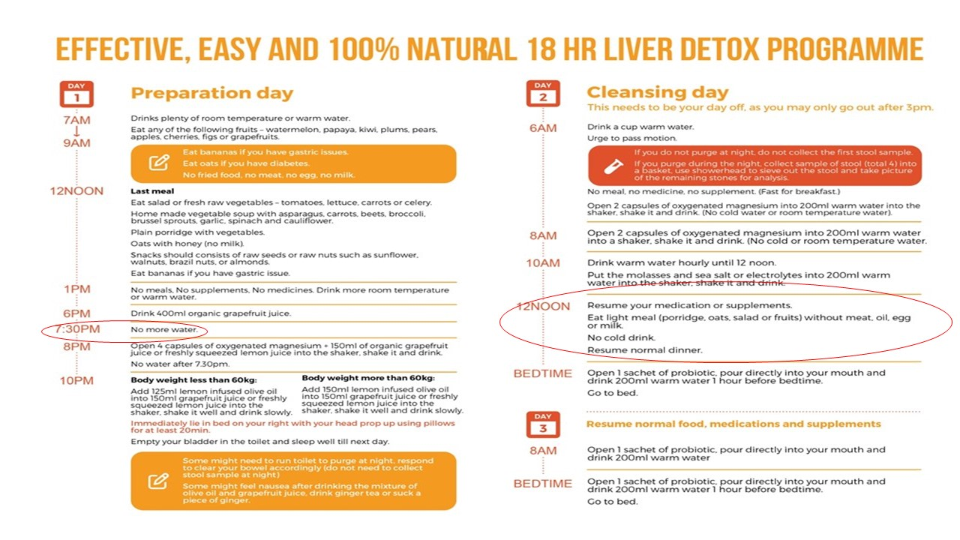

Slide 27
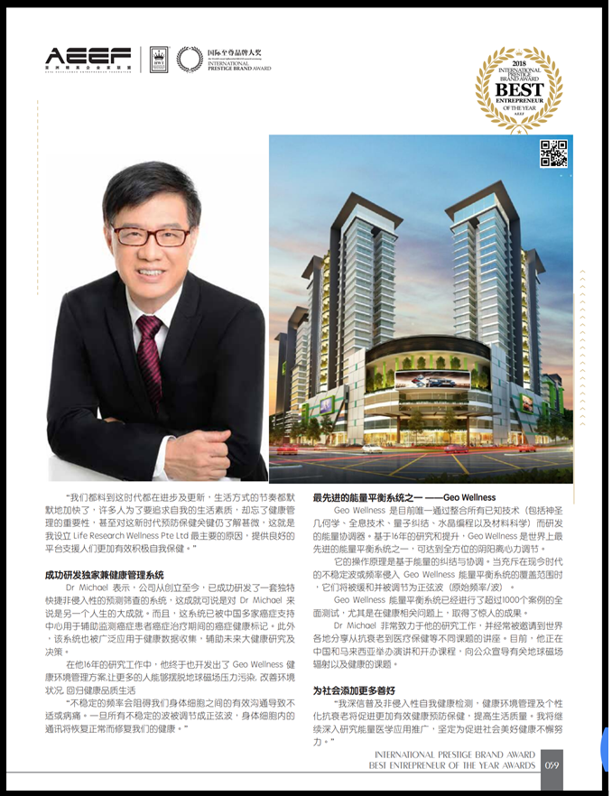
Dr Michael Tan, (PhD in Geopathic Stress)
Energia Adviser and Researcher
Electrical engineer in Singapore Power for 24 years
2000 – started research on Energy Medicine
2012 - Founder Life Research Wellness Pte Ltd
2014 – Started deep research on Geopathic Stress and started Geo Origin Technology and Geo Wellness
2016 – Dr Michael champion the real estate movement as lead consultant for Dreamhomes in Cyberjaya, KL, Malaysia
Modified the State-of-the-Art 7-in-1 Wave Modulation Technology in Miracle Energy of Life and Miracle Water of Life
Patented the Wave Modulation Technology

Slide 28
Chaos

Slide 29
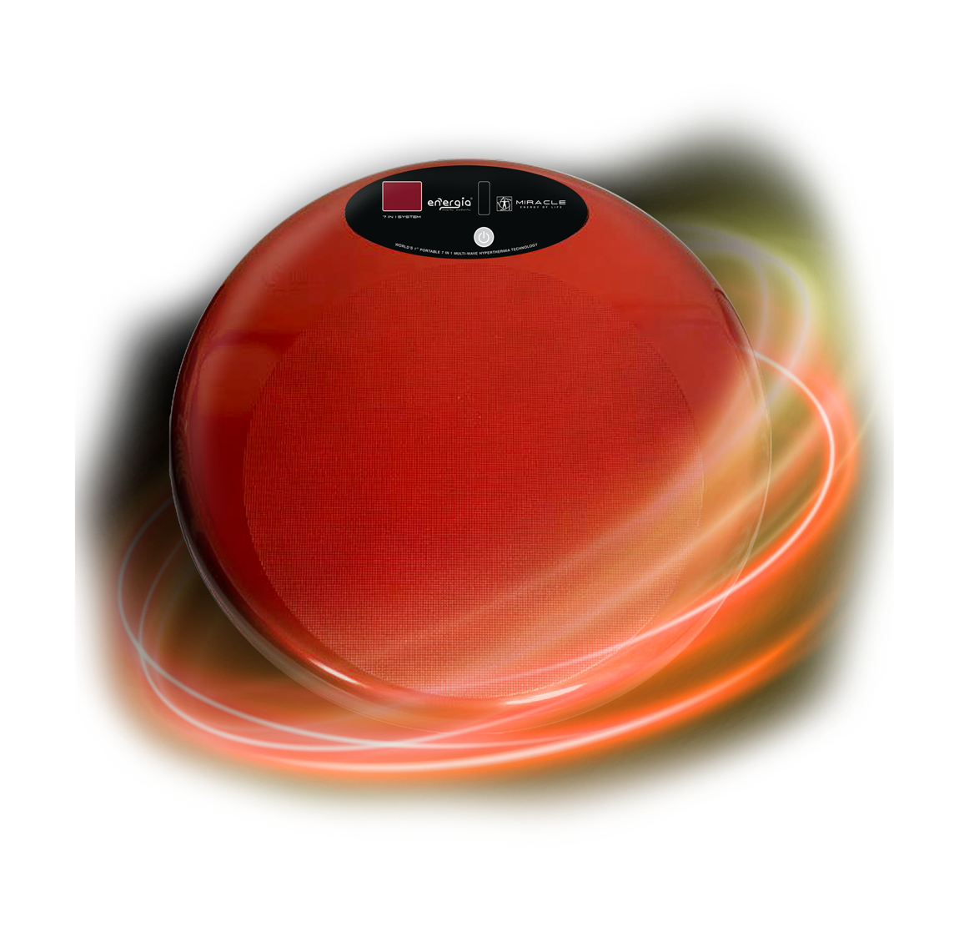
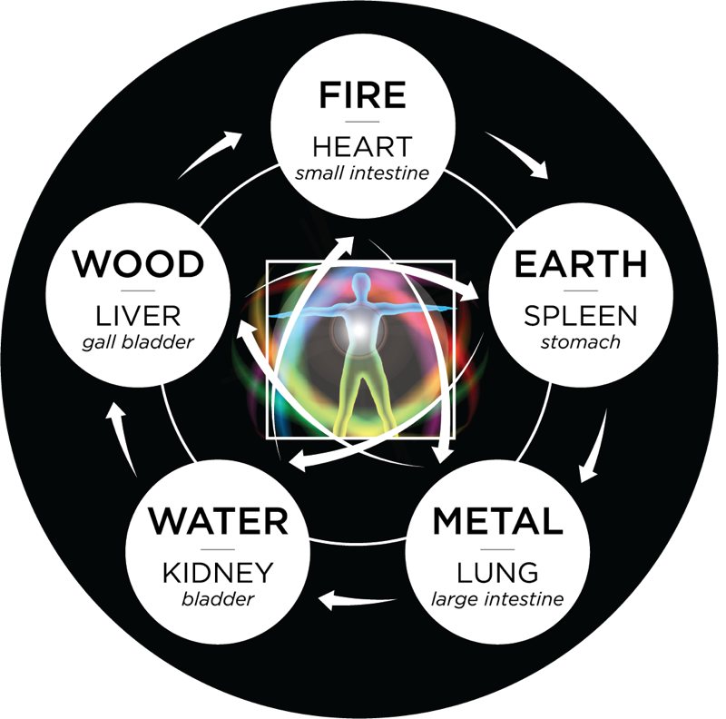
World’s First state-of-the-art 7-in-1
Wave Modulation Technology that
Regulates, Regenerates, Recharges and Harmonises
your Bioenergy field and 5 elements at Cellular level;
Centre the Qi at Diaphragm
+ Pain-free therapy
+ Non-Invasive
+ Natural Healing
+ Scientifically Proven
+ Revolutionary Technology

Slide 31
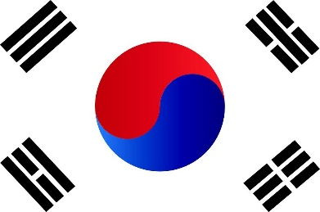
World’s First Structured Water with Hado Crystals from 8-In-1 Water Filtration System using
Wave Modulation Technology
Live Well With Premium Grade,
Pure water as Nature intended
and much more...
Purified (TDS 49)
Mineralised
Mild Alkaline (pH 8.5)
Hydrogen
Antioxidant (- 600 ORP)
Micro-cluster (62Hz)
Energised water (with +ve pendulum spin)
Structured water with Hado Crystals
No Electricity
required
MADE IN KOREA

Slide 32
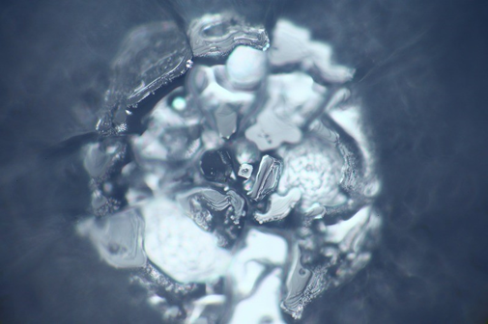
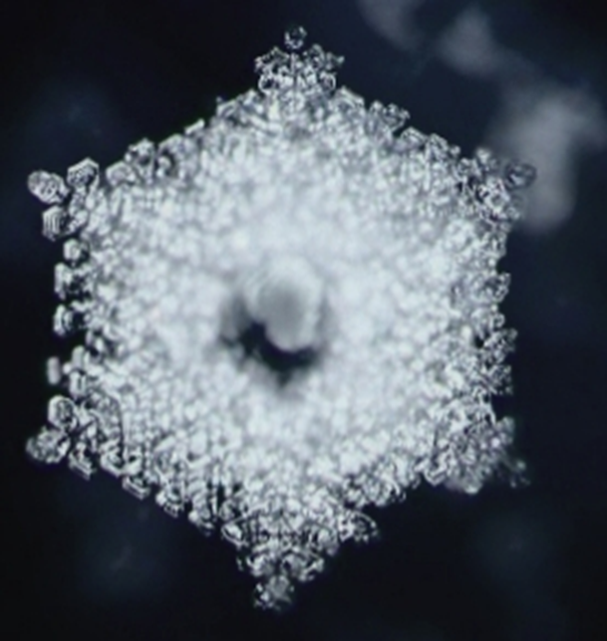
Miracle Water of Life Hado Crystal test at
Emoto Lab, Tokyo Japan
December 2019
WATER MOLECULES IN PERFECT CRYSTALLISED GEOMETRIC SHAPE AFTER STRUCTURING
WATER MOLECULES FROM
NON STRUCTURED DRINKING WATER
WAVE
MODULATION
TECHNOLOGY
Water Structuring with WMT
UTILISING OUR WMT™ WAVE MODULATION TECHNOLOGY,
WATER MOLECULAR STRUCTURE ARE GEOMETRICALLY, PERFECTLY FORMED

Slide 33
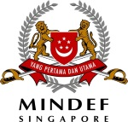
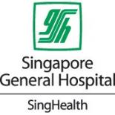
Past Corporate Talks

Slide 34
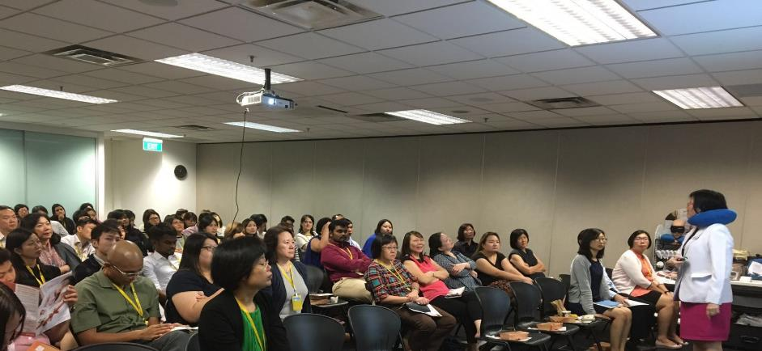
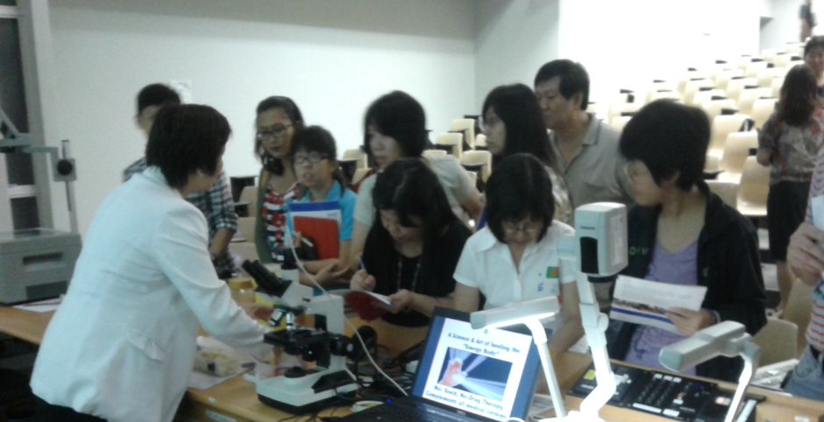
Live Webinar
Health Talk At Aviva
Online Community Events
Health Talk At Ntu

Slide 35
Corporate
Wellness
Offer
You Cannot Come To Us,
We Go To You!!

Slide 36
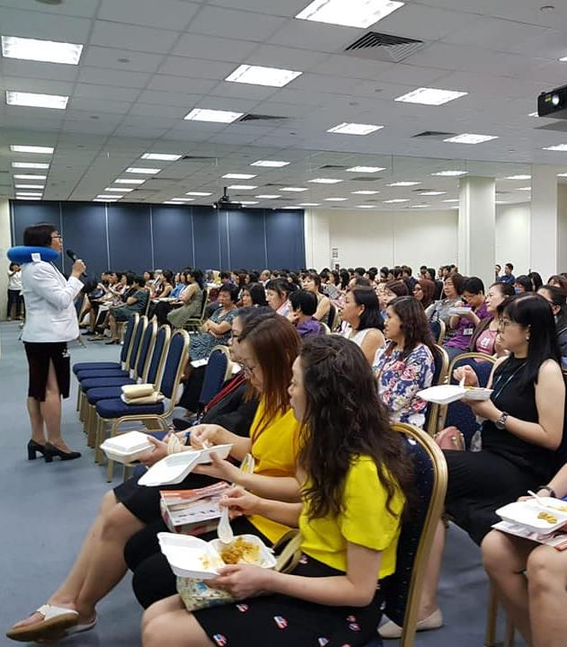
Why Do Corporate
Organisations
Work With Energia?
Healthy staff
Lower Medical cost
Less MCs
Higher productivity with positive work environment
Talent retention
Higher energy staff
More motivated
More focused
More creative, happier, and healthier with no aches and pain

Slide 37
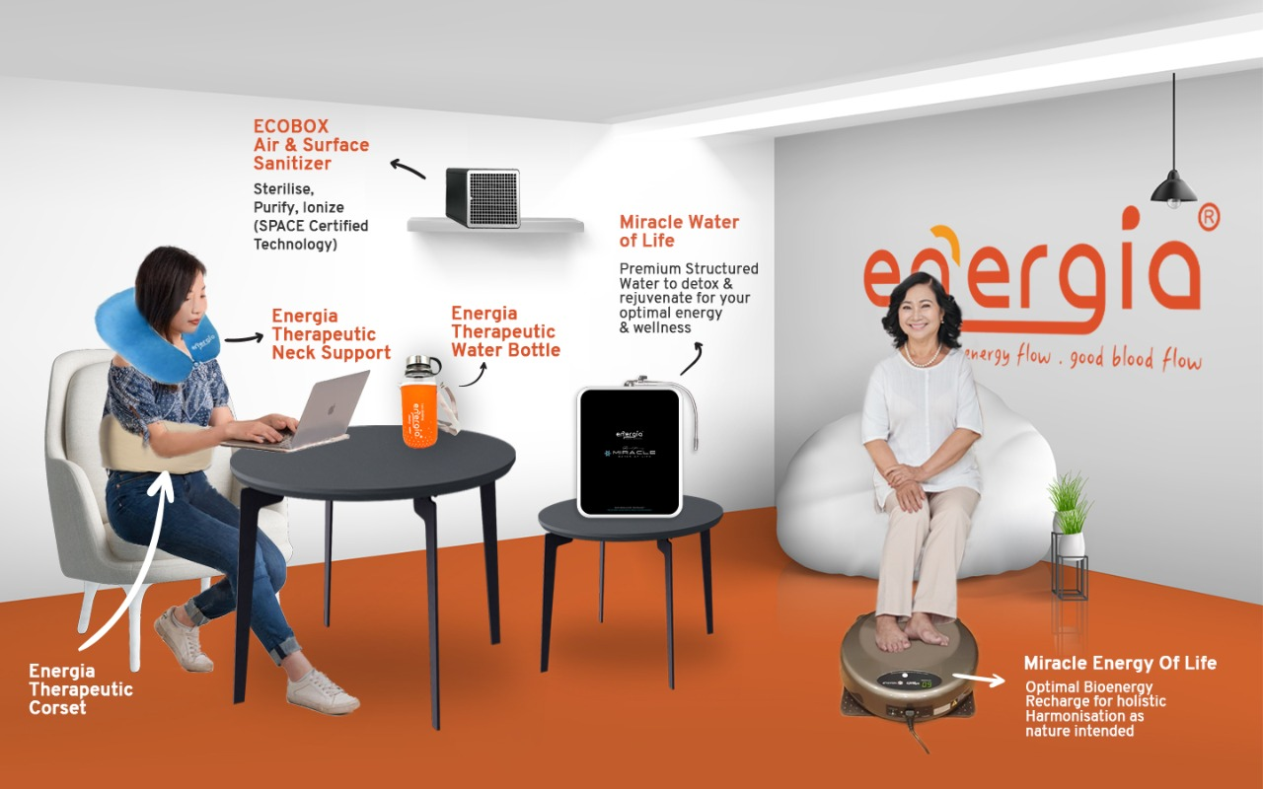
Corporate Wellness Corner Set-up

Slide 38
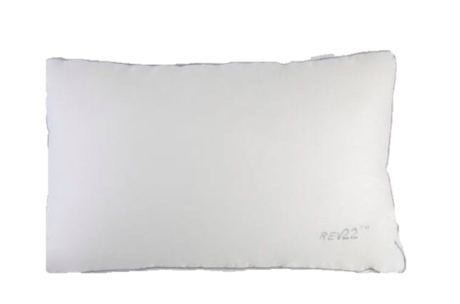
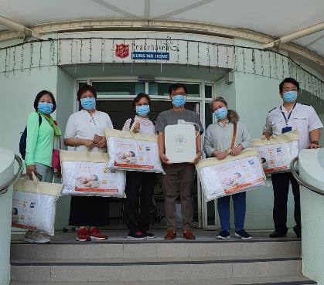
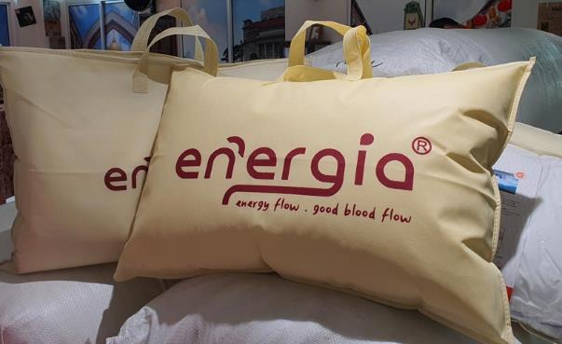
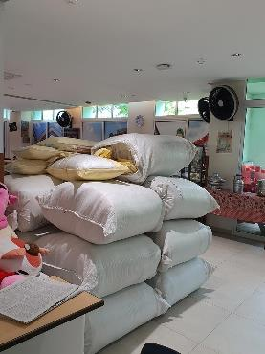
Corporate Social Mission
Energia donates 200 pillows to peacehaven nursing home in March 2021
Energia Therapeutic Pillow
$327
Improve sleep quality for elderly
Able to be more sociable during the day
Able to feel happier and healthier after enjoying good night’s sleep

