Slide 1

Stronger SMEs, Stronger Societies
Brands for Good 2021 - Business For Good
May 2021

Slide 2
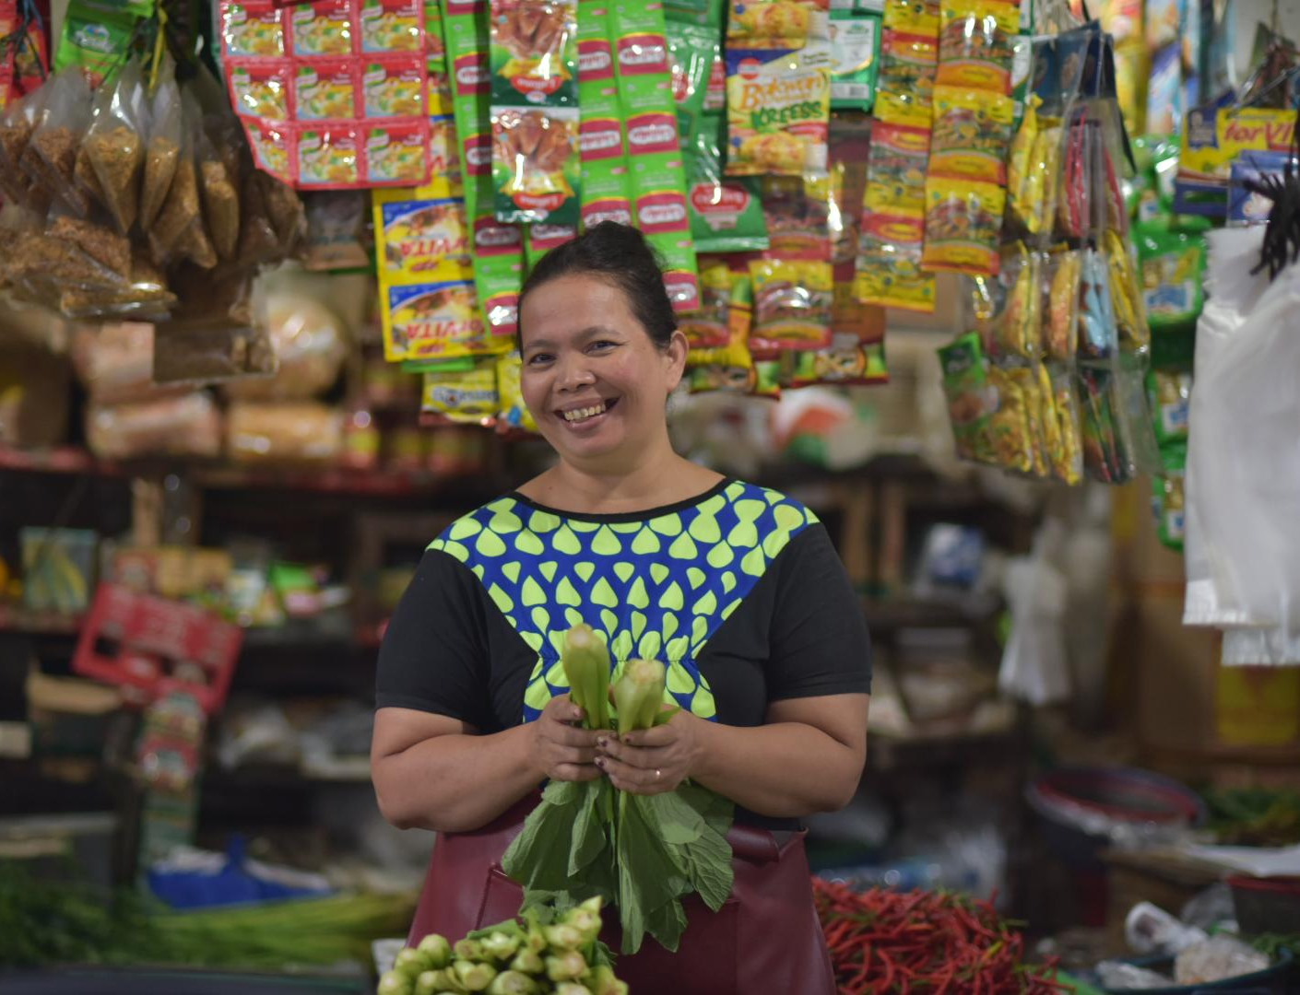
Funding
Micro & Small Enterprises (MSMEs) in Southeast Asia

Slide 3
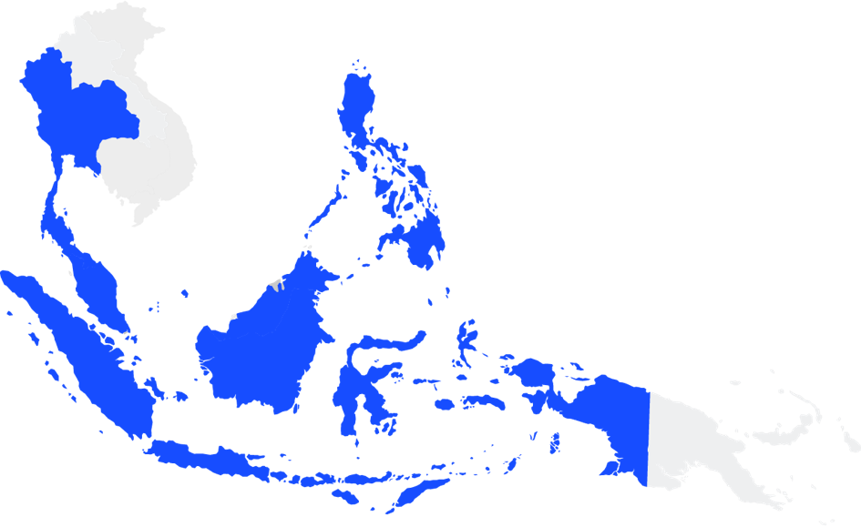
MSMEs in Southeast Asia
In ASEAN-5¹
US$1.1T
58% GDP
3 out of 4 jobs
99% enterprises
¹ Singapore, Indonesia, Malaysia, Thailand and Philippines
II

Slide 4
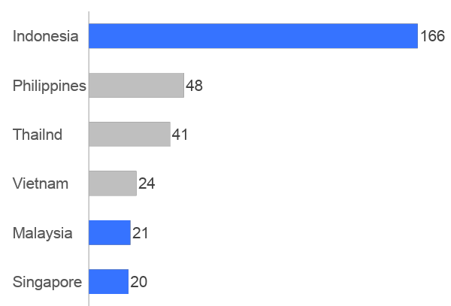
Yet 60% of MSMEs are financially under-served
leading to huge gap
Country
Gap by count²
% un/under-served
74%
US$320B
62%
MSME financing gap¹ or
60% MSMEs
Thailand
58%
n/a
Below 1%
~US$200B credit gap in ID, SG & MY
55%
Served by digital financing³
60%
¹ World Bank IFC, 2011/ 2017 “SME Finance Forum”, by benchmarking economies for potential demand and subtracting supply.
² PWC , 2019 “Indonesia’s FinTech Lending” and Deloitte, 2015 “Digital Banking for SMEs”
³ Based on competitors’ announced volume, government reports and company estimates

Slide 5



Who are we?
Repayments
Short-term credit to SMEs
Lends to a spectrum of firms, from micro to medium sized. Both secured & unsecured products, <12 months
MSME Digital Financing Platform with software ³ for SMEs
Largest in ASEAN
Short-term investment to public
80% individual | 20% institution
50% crowdfund | 50% balance-sheet
Loans
Note: ³ Software-as-a-service
Source: FSMK

Slide 6








Hybrid model for MSME credit financing
Unique model allows for flexibility and faster MSME financing fulfilment
On-BS lending
INVESTORS
Interest income
Misc. fees
FSC
Retail
Institution
PLATFORM
Origination fee (from MSMEs)
Service fee (from investors)
Misc. fees
Crowdfund
Funding Societies
BORROWERS
Increases disbursement speed
Improves probability of MSMEs being funded
Micro, Small & Medium Enterprises

Slide 7














Role of debt crowdfunding
To fill the funding gap in an enterprise’s lifecycle
Micro-Enterprise
Small/Mid Enterprise
Large Corporate
Multi-National Corp
Internal/Informal funds
P2B financing
Bank financing
Capital markets
Friends & family

Slide 8
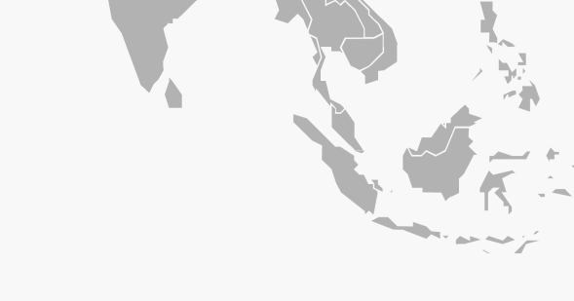





Largest platform in Southeast Asia
Funding Societies Thailand
Securities and Exchange Commission licensed
Licensed & Operating in
~206,000
Community of retail investors
Funding Societies Malaysia
SC RMO approval
Total funded regionally
S$2 billion+
No. of loans given out
4 million+
Funding Societies Singapore MAS CMS license (retail)
Strong credit & tech
1.28% defaults²
Regional team strength
350+
Modalku¹
OJK licensed
As of May 2021
¹ Local Bahasa name for localization
² 60 dpd (invoice) & 90 dpd (term financing) as per bank. % disbursement

Slide 9
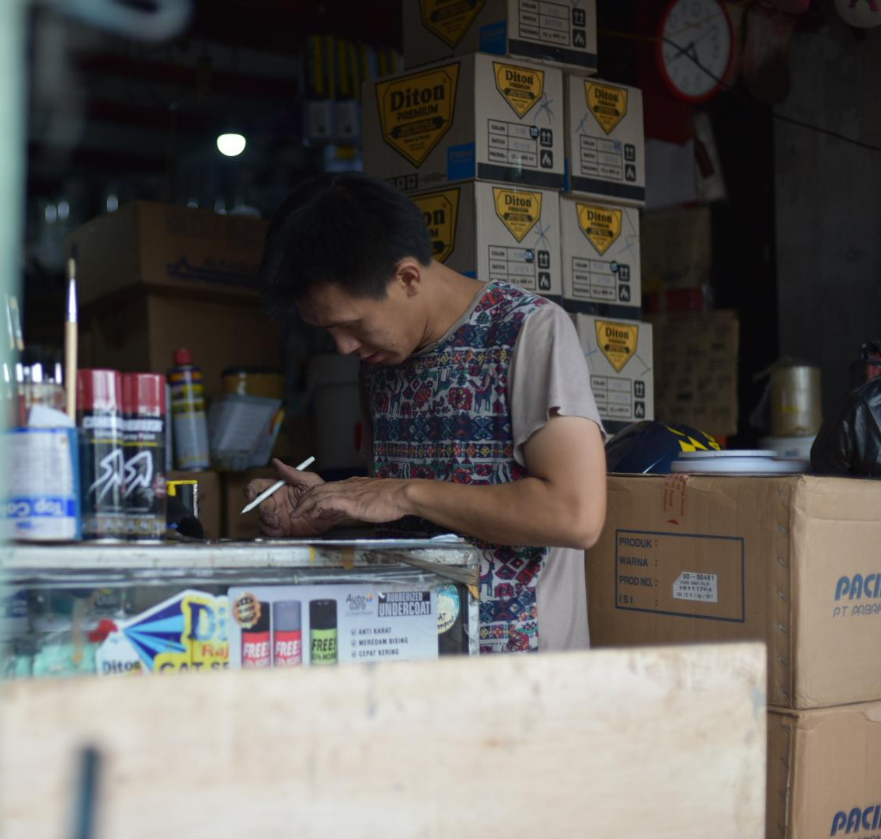
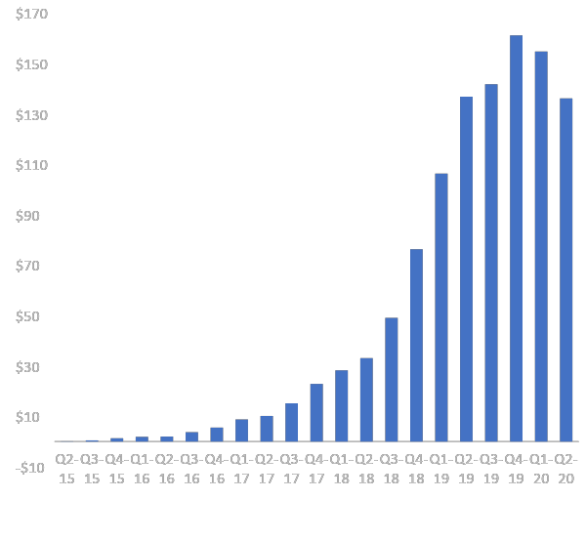
We pride ourselves on steady and holistic growth
Quarterly loan origination, US$ mil
$161m
Covid-19
$136m
310% CAGR
since 2015

Slide 10




With the goal of serving Southeast Asia
January 2016
Launched Indonesia as Modalku (“My Capital”)
August 2014
Met at Harvard
February 2017
Launched Malaysia
2020
Series C, PFI (ESG)
2014
2015
2016
2016
2017
2018
2020
2021
June 2015
Launched Singapore
August 2016
US$ 7M Series A led by Sequoia India
April 2018
US$ 25M Series B led by SoftBank Ventures
Asia Corp.
Feb 2021
Launched Thailand,
US$ 1.5B disbursed

Slide 11
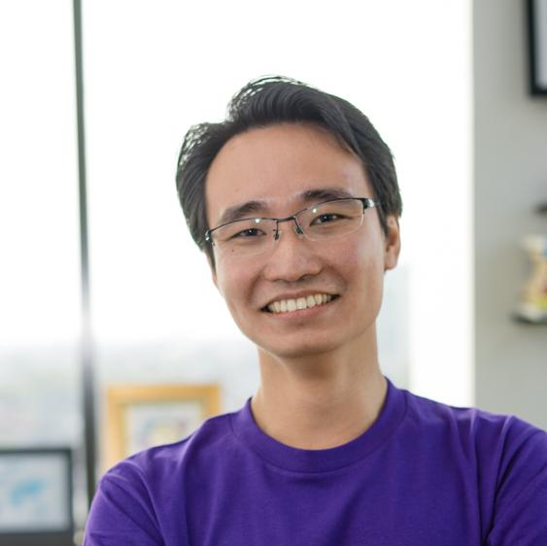
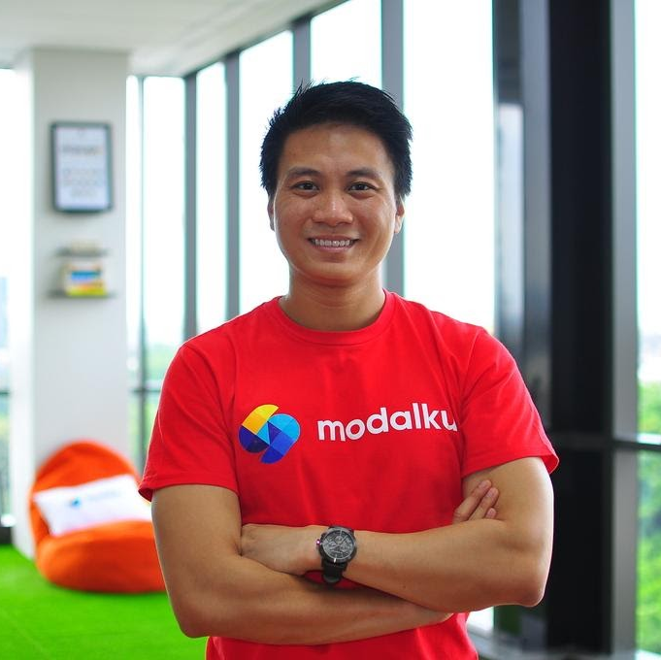



Meet our Founders
Kelvin Teo
Co-founder and Group CEO
Reynold Wijaya
Co-founder
Co-Chairperson for the Marketplace Lending Committee of Singapore FinTech Association.
A consulting professional at KKR, McKinsey and Accenture prior to starting Funding Societies.
Graduated from Harvard Business School and National University of Singapore, and is a certified Chartered Accountant.
Aims to build a better Indonesia through business impacts.
Previously an Executive at United Family Food, one of Indonesia's largest confectionaries, where he drove expansion.
Graduated from Harvard University and The University of Michigan.

Slide 12
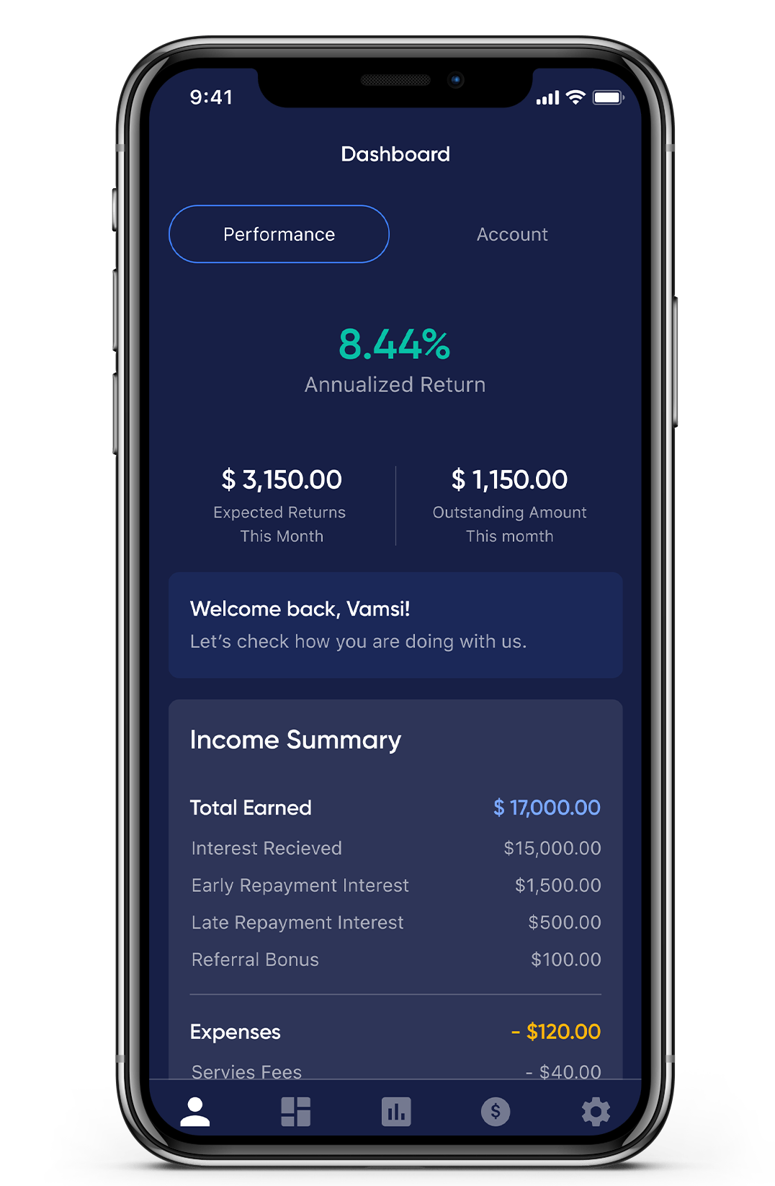
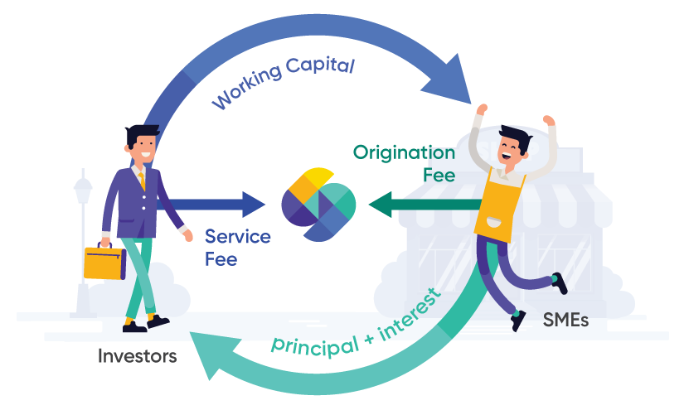
Investors support MSMEs through a digital platform
Investors earn returns
MSMEs access funds
Retail &
Institutional investors
Micro & Small listed companies
Want new opportunities
To diversify portfolio
Start with smaller investments
Prefer short-term investments
Have financing requirement
For expansion or working capital
Lack track record to qualify for bank loans
Want to top up bank loans
Need funds fast, short-term

Slide 13


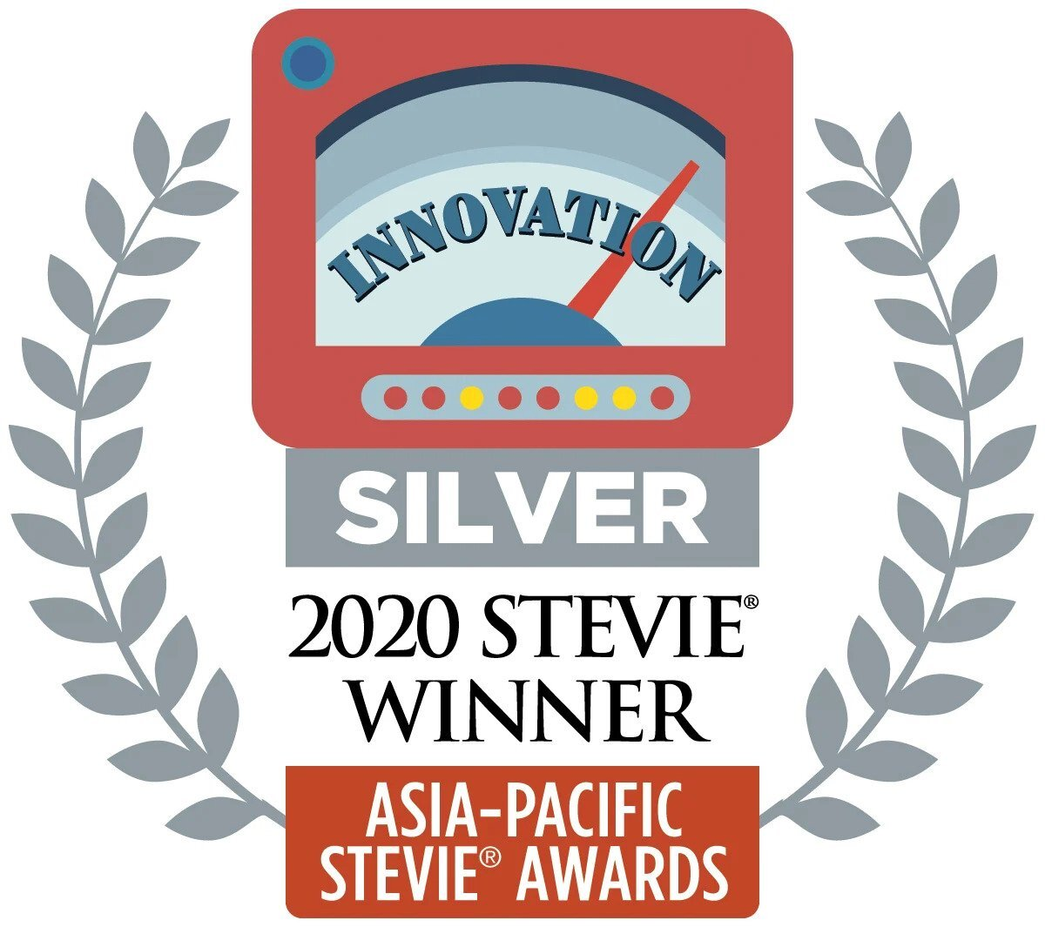
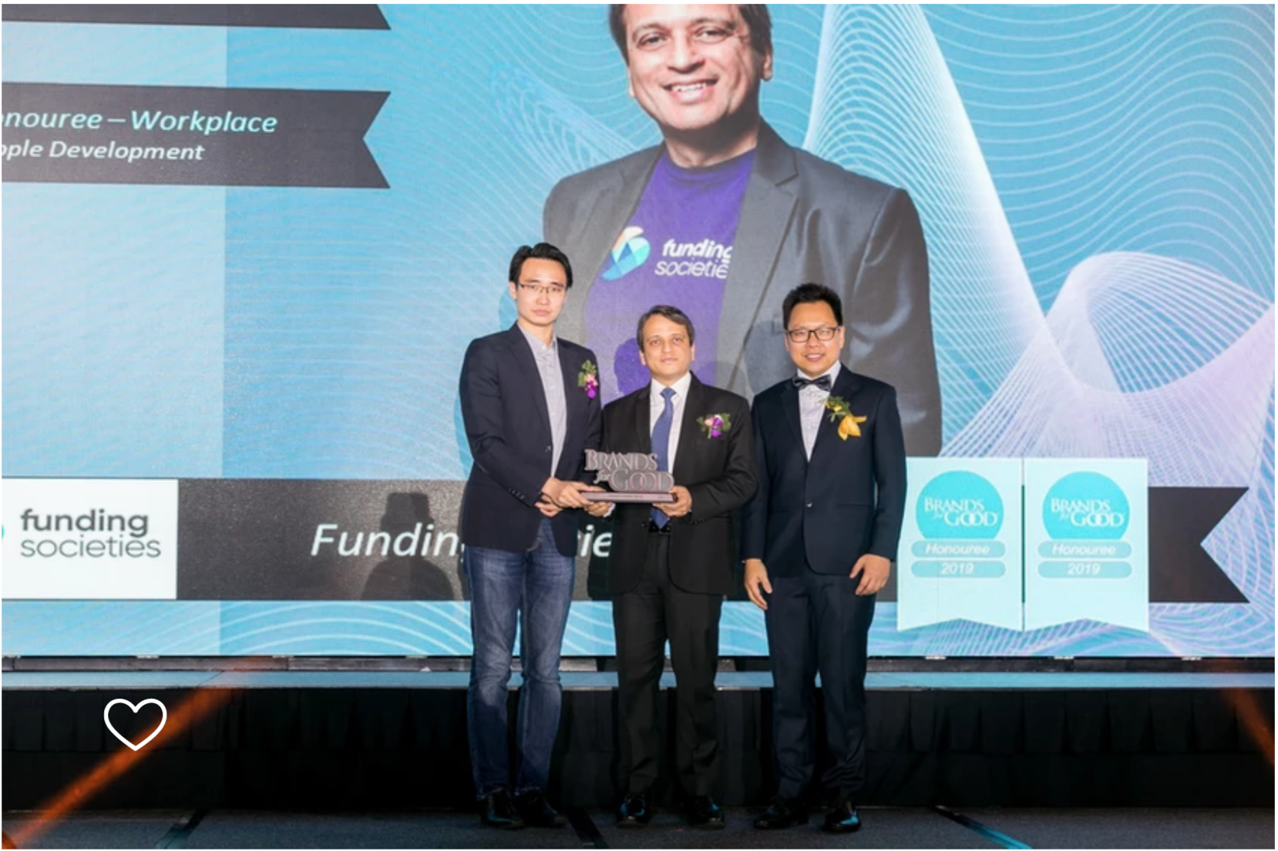
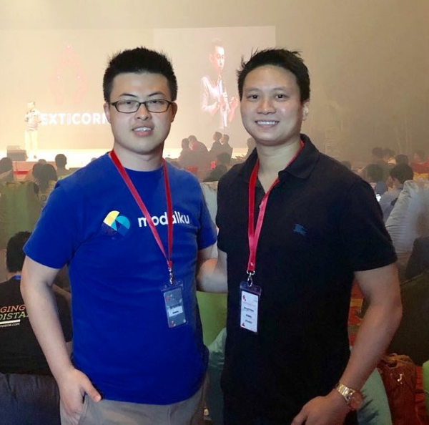
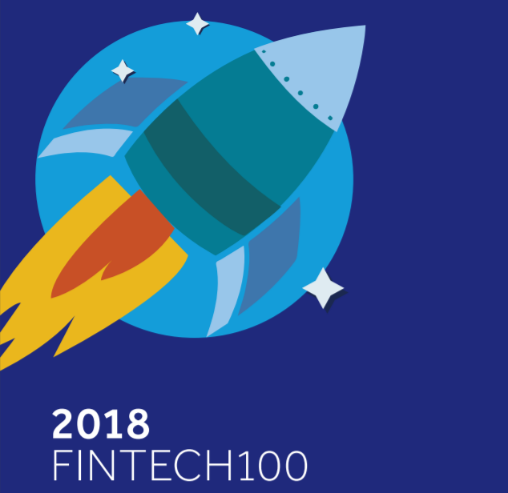
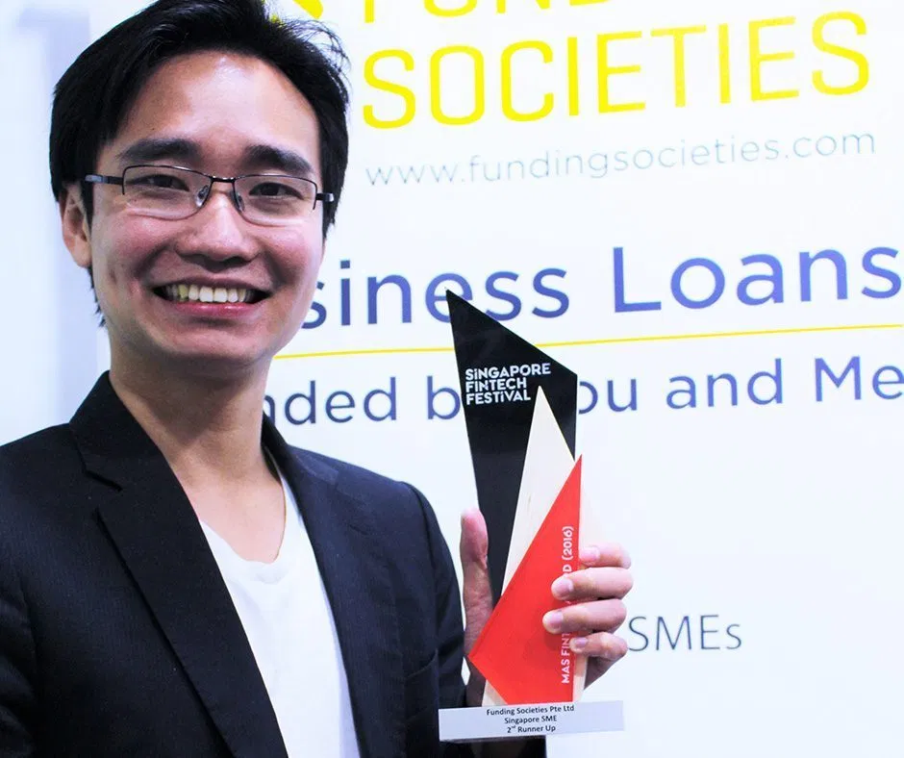
Awards and recognition locally & globally
Thought leader in the Fintech industry
ASEAN Startup Awards 2020 winner in 2 categories
Awarded Startup of the Year and Founder of the Year
Driving Figure of Fintech in Supporting the National Economic Recovery Programme - Indonesia
Recognition by OJK at the Inclusive National Economic Reform Momentum, expressed in front of President Joko Widodo
Stevie® Award
Silver medal for Innovation in Technology
Top 5 FinTechs in Singapore
Recognised in IDC Financial Insights’ FinTech Fast 101 research 2020
Brands for Good 2019 winner in 2 categories
Recognised for business model for positive social impact
Winner of Microenterprise Challenge 2018
By United Nations CDF, for positive social impact with microloans
Amongst Top 100 FinTechs globally
Recognised by KPMG and H2 Ventures
MAS Fintech Awards (Singapore SME)
Awarded at Singapore Fintech Festival 2016

Slide 14
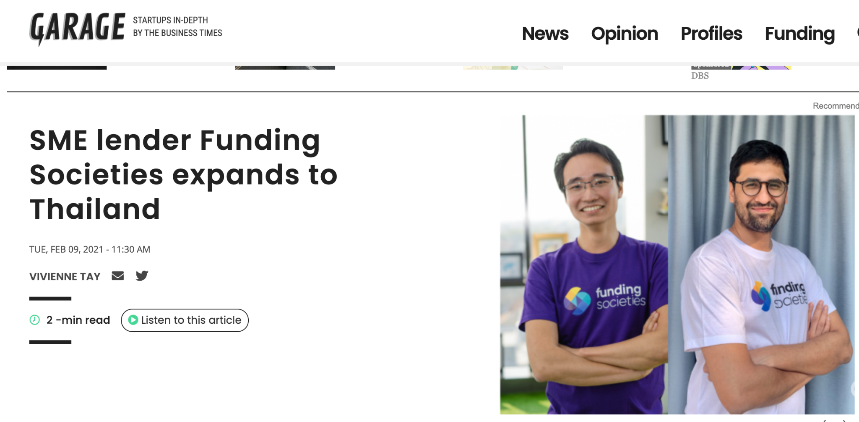
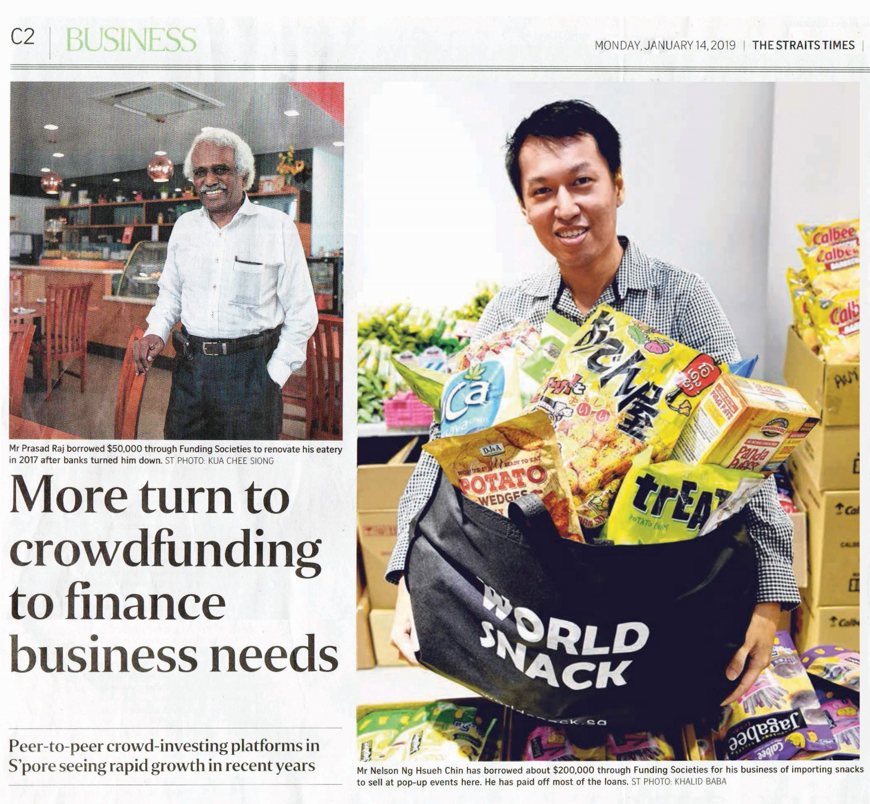
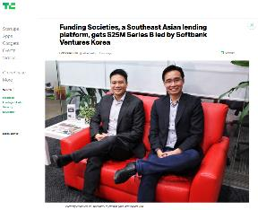
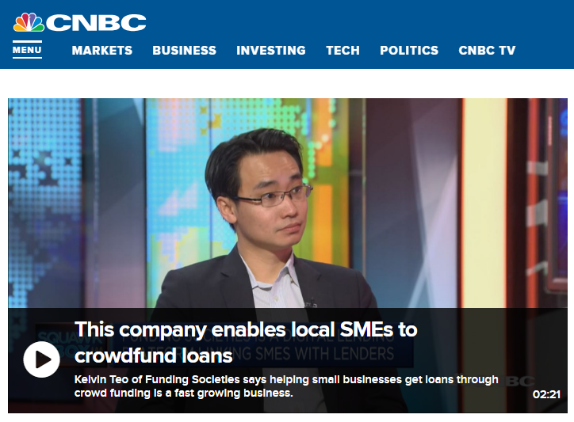

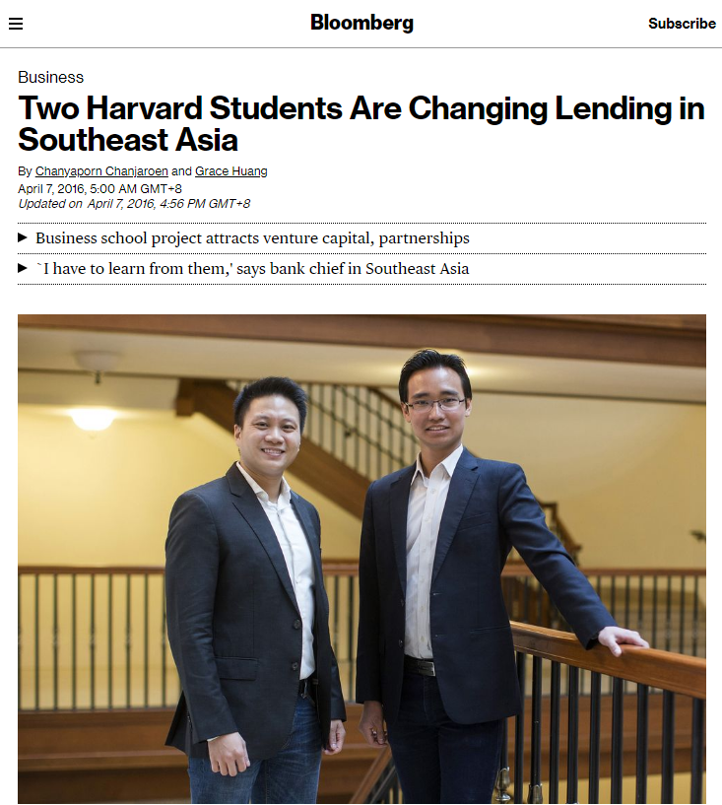
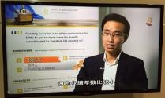
Coverage by mainstream media
Strong presence in local & global media
Local – Straits Times, Business Times, Zaobao
SME stories on crowdfunding, Women in Tech, Expansion to Thailand, Partnerships
Global – Bloomberg, TechCrunch, BBC
Series B News, SME Financing
Technology – Tech in Asia, e27
Key people interviews, SME financing the tech way
Broadcast – CNBC, Channel 8
About FS, GovTech

Slide 15
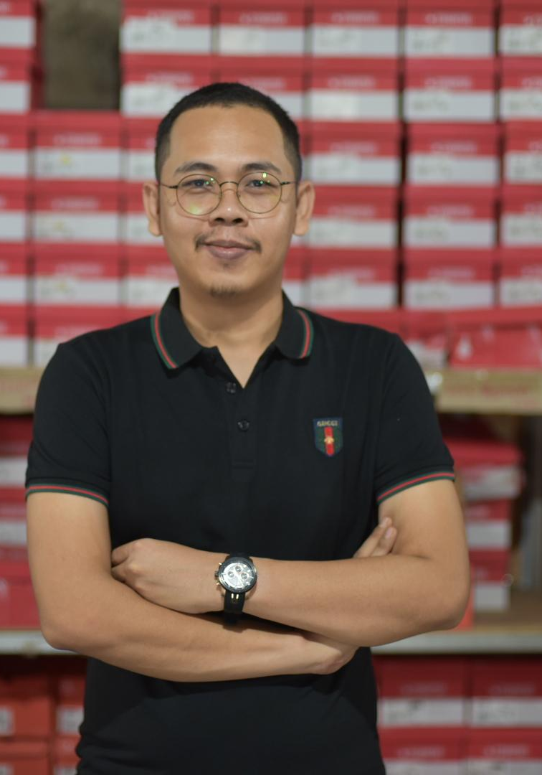
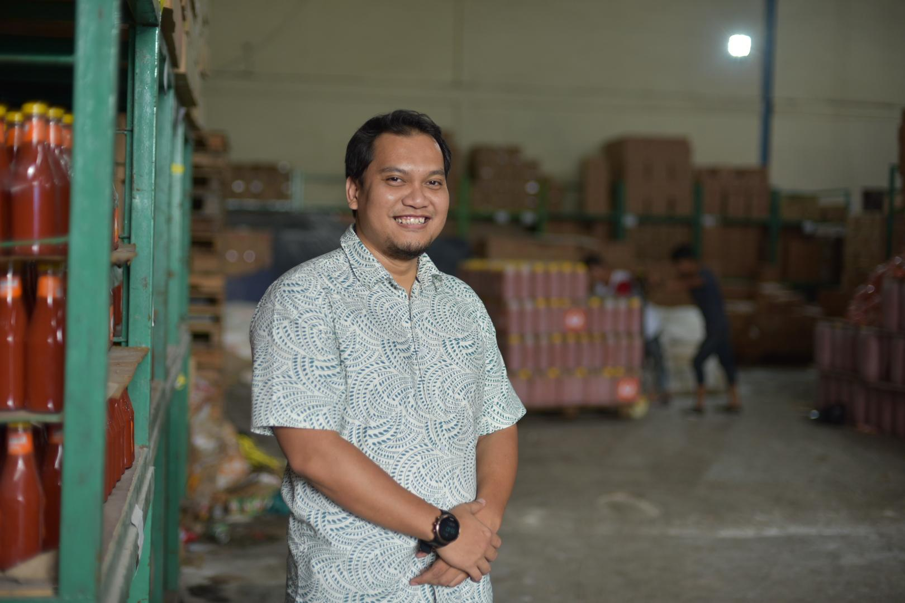
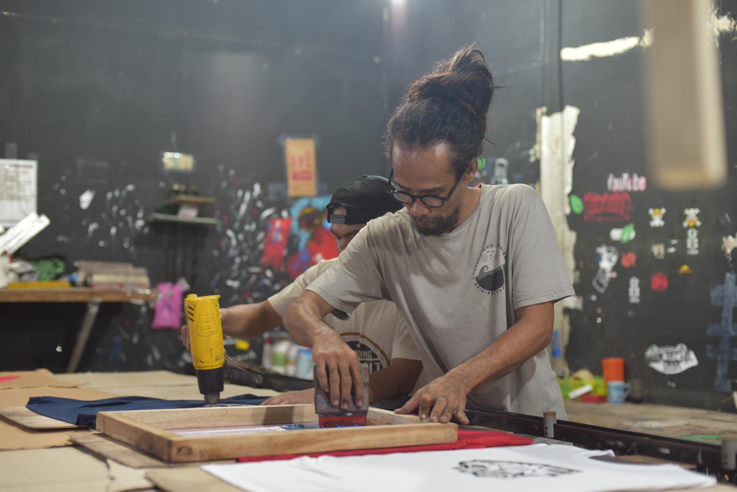
Who are the MSMEs we are supporting
What they’re looking for
First-time loan
Short-term financing for bridging purposes
Quick access of funds
Top up existing bank loans
Additional line of credit

Slide 16


Providing MSMEs with more access to financing
Key differences | Traditional FIs |  | Funding Societies
Target segment | Prime SMEs (larger SMEs with collateral) |  | Micro to medium SMEs (Asset-light or with collateral)
Products | Secured, Conventional |  | Secured and Unsecured
Duration | Long (2-5 years) |  | Short (up to 12 months)
Value proposition | Offline, larger and cheaper |  | Digital, faster and customised

Slide 17

Continuous Innovation for our retail investors
Business Term Investment (BTI)
Property-backed Secured Investment (PBSI)
Guaranteed Property-backed Investment (GPI)
2015
2016
2018
2019
2020
Invoice Financing Investment (IFI)
Guaranteed Returns Investment (GRI)
Revolving Credit Investment (RCI)

Slide 18
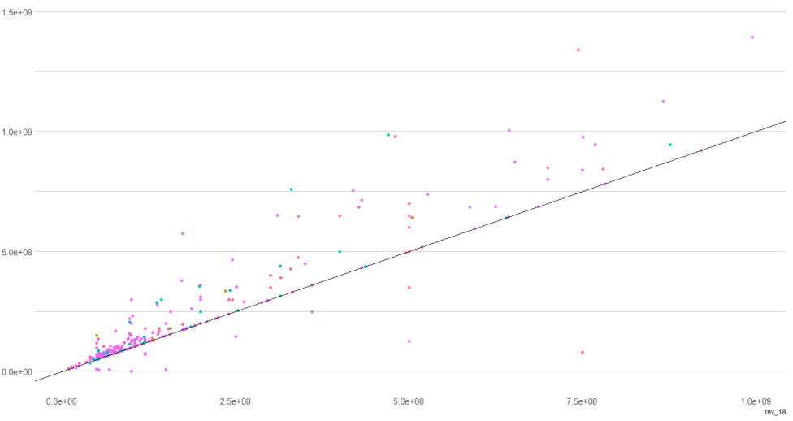
Measuring Our Impact (A Study conducted with a regional development bank)
Scope
Collaboration between Funding Societies (FS) and a regional development bank to conduct a study on the economic and social impact of FS’ lending in Singapore, Indonesia, and Malaysia.
Method
Using national and multi-regional input output tables, and data collected from FS’ internal systems and user research, the Bank uses a hypothetical extraction method to simulate the impact to the local economies from FS-linked MSMEs in 2018 and 2019. Sector, revenue, expense, depreciation, employee numbers plus many more data points are factored into the program that creates the outputs.
Scatter plot supplied by the Bank showing revenue growth for Funding Societies backed MSMEs from 2018 and 2019.
Dots above the line show YoY revenue growth.
Notes:
IO tables provide highly detailed information on the ultimate location of an industry’s products. Specifically, IO tables tell us how much of an industry’s output is used by other industries, consumed by households or government, invested by the private sector or government, or exported. As such, IO tables can be used to gauge which bodies of consumers are most important to particular industries.

Slide 19
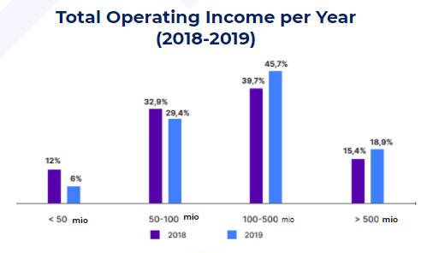
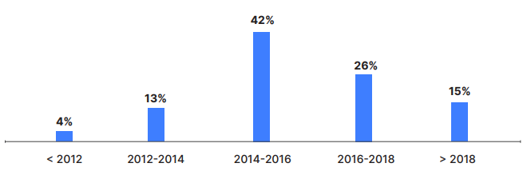
Measuring Our Impact - The DS Innovate Study
Scope
Working with Daily Social - Innovate to survey and study MSMEs that took funding from FS in 2018 and 2019 to give demographic, economic and social insights.
Method
Online survey and telephone discussion to collect ~35 points of data including demographic, financial, business performance, opinion.
Output
This study helps us establish MSME demographic profiles and information to show us the effects from better financial inclusion.
Business establishment years
Notes:
DS/innovate is a Jakarta-based innovation consultant and research firm. We help companies and enterprises connect to Indonesia’s startup ecosystem through advisory, research, hackathons and incubators/accelerator programs. We also enable organizations to innovate from within by embedding innovative mindset through education and trainings.

Slide 20
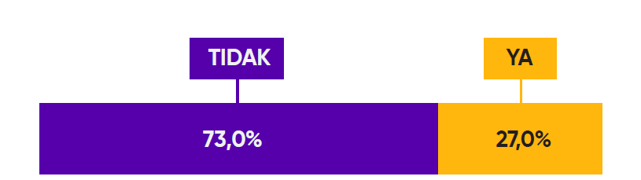
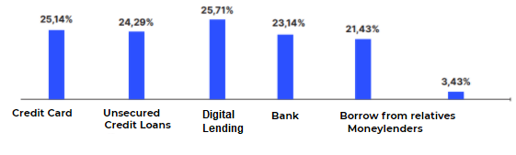
Measuring Our Impact - The DS Innovate Study
Only 27% of MSMEs have applied for loans from conventional financial institutions
Source of respondents' business loans
No
Yes
Credit Card Unsecured
Credit Loans
Bank Borrow from relatives Moneylenders
Nearly 50 percent of micro businesses view business licensing as a barrier, while more than 50 percent of micro businesses view financial reporting as restrictive.
25.7 percent of MSMEs said Digital Lending was their top funding source among all sources.

Slide 21
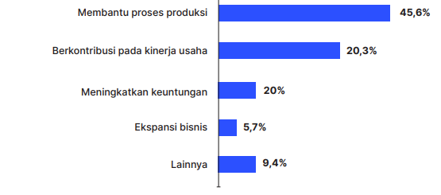
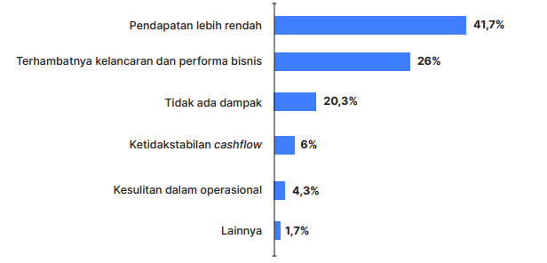
Measuring Our Impact - The DS Innovate Study
Benefits of loans received by MSMEs
The impact of financial exclusion
Helping the production process
Contribute to business performance
Increase profits
Business expansion
Others
Lower income
Impaired business performance and smoothness
There is no impact
Cash flow instability
Operational difficulties
Others
Based on the survey results, as many as 20.3 percent of respondents thought that financing from Digital Lending contributed to improving their business performance, especially supporting the smooth running of their daily operations and financial constraints related to this.
As many as 41.7 percent of MSME players agree that not getting a loan from Funding Societies | Modalku has enough of an impact on the success of their business, where lower income will be the main impact of this.

Slide 22





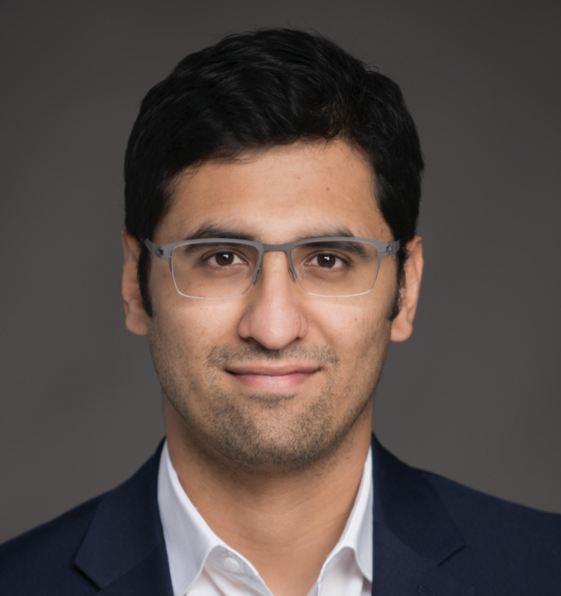
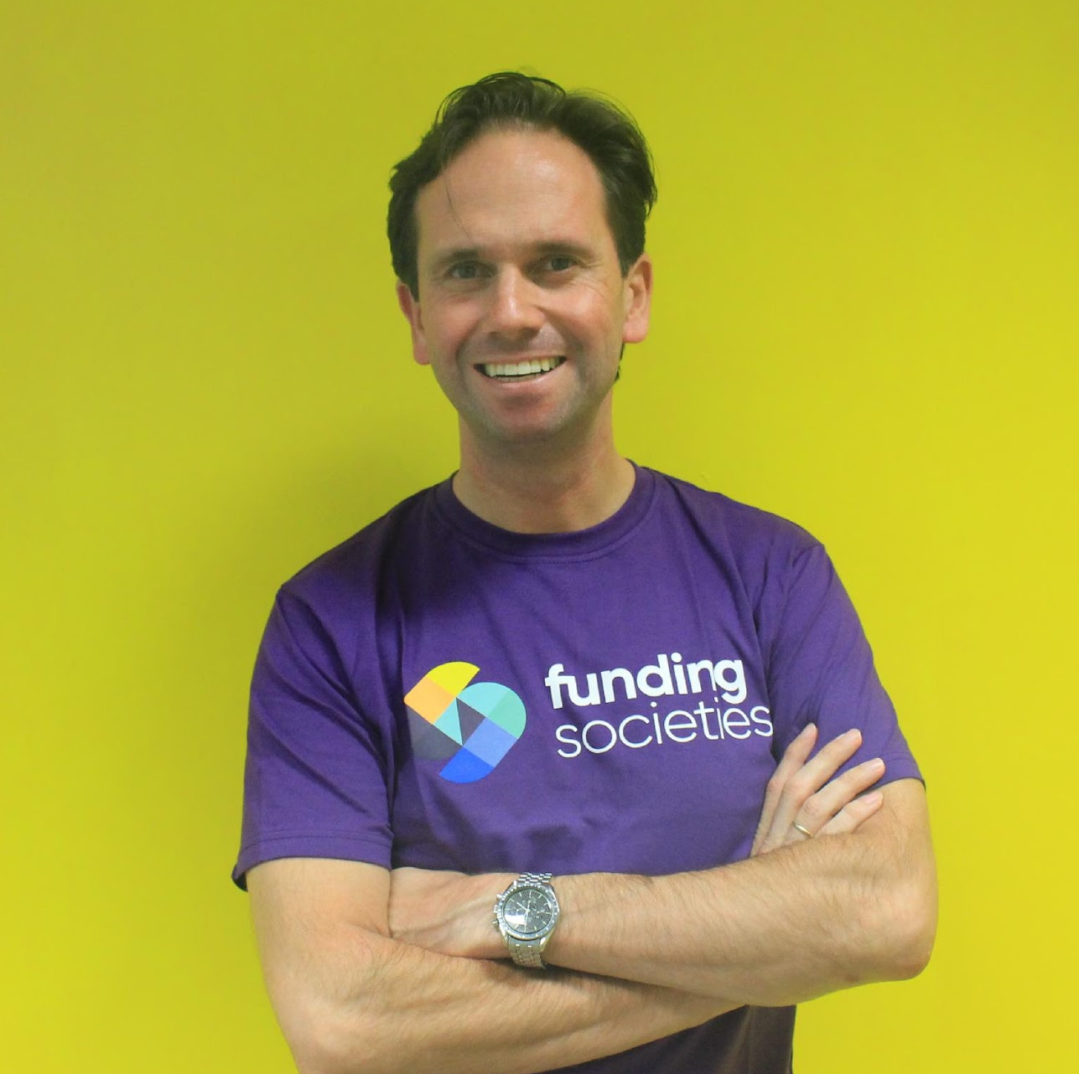
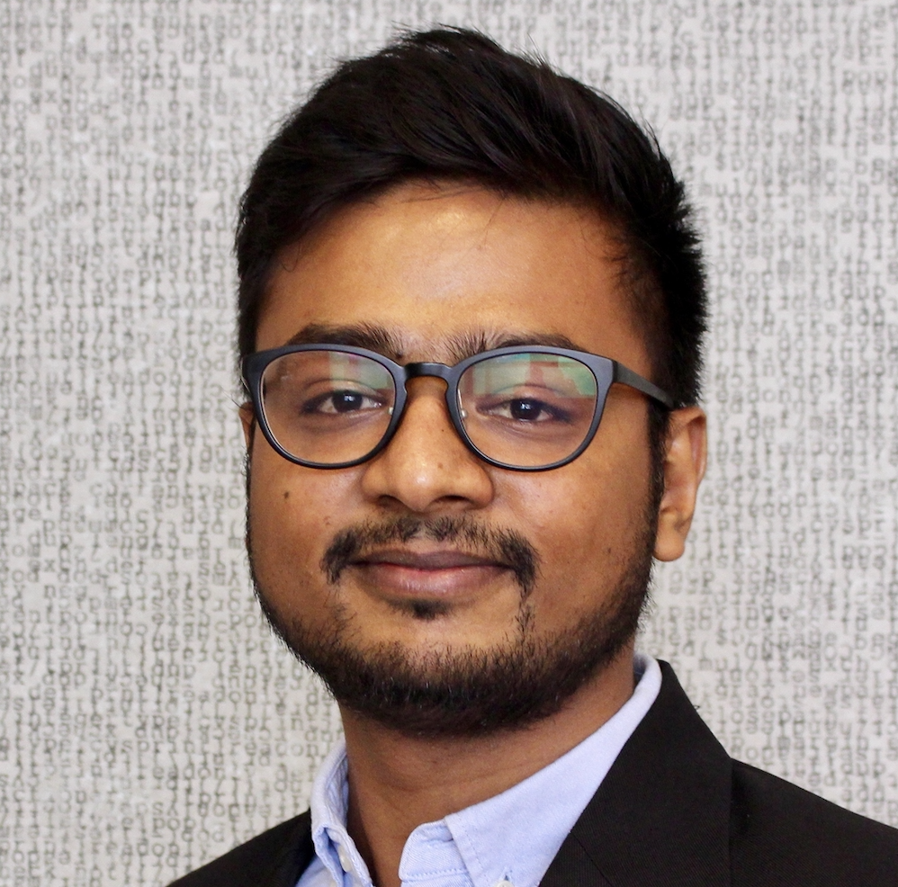
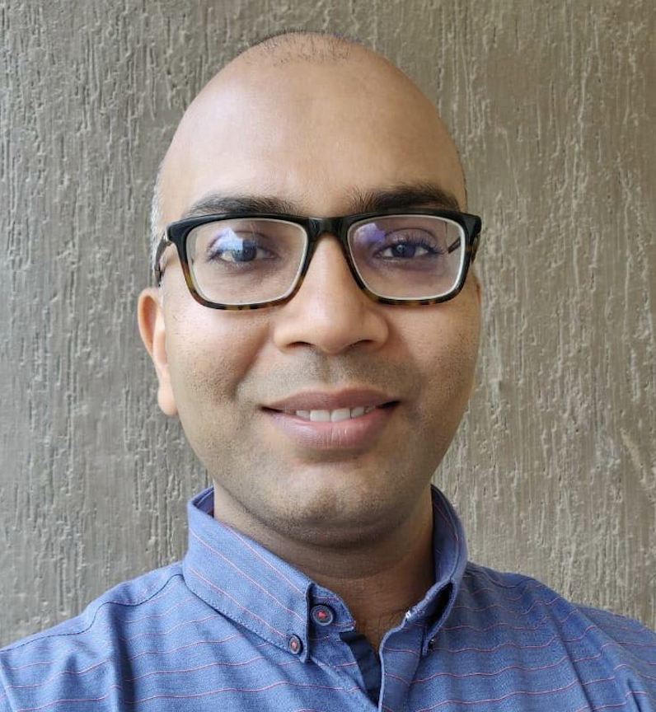
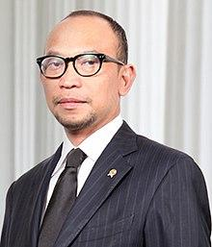









We have a proven team and shareholders to succeed
Kelvin Teo
Co-founder, Group/ SG CEO
Accenture, McKinsey, KKR, HBS
Reynold Wijaya
Co-founder, Group COO
United Family Group, HBS
Iwan Kurniawan
Country Head, Indonesia
Oliver Wyman, Cornell
Wong Kah Meng
Country Head, Malaysia
Oliver Wyman, CFA
Varun Bhandari
Country Head, Thailand
IFC, Deutsche, Harvard, IIM-B, LSE
Frank Stevenaar
Chief Finance Officer
GoBear, Aegon, KPMG
Ishan Agrawal
Chief Technology Officer
Viki (Rakuten), Founder
Nihit Nirmal
Chief Product Officer
Lendingkart, PayU, Inkfruit
Pak Chatib Basri
Senior Advisor
Ex-Finance Minister, HBS

